Slide 1
Text preprocessing
An academic guide for business users with a case study

Slide 2
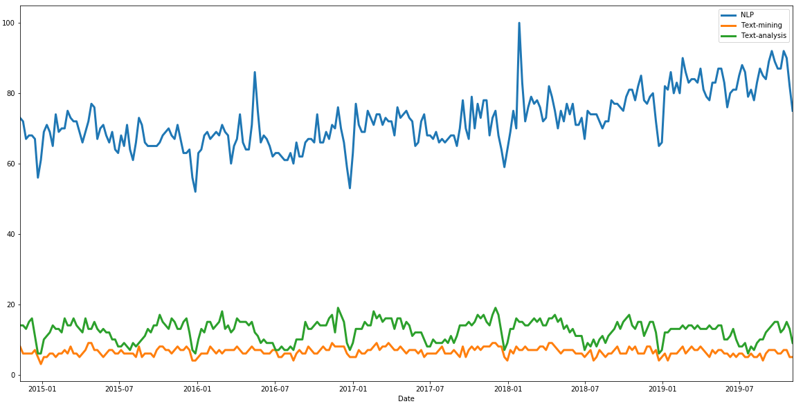
Interest over time

Slide 3
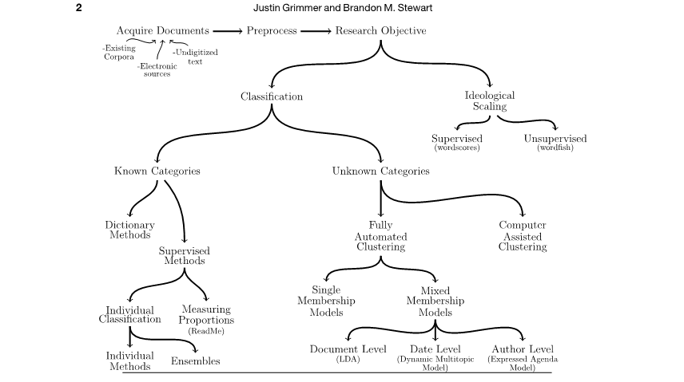
Text mining in academia

Slide 4
Ideological scaling
Wordfish model (unsupervised)

Slide 5
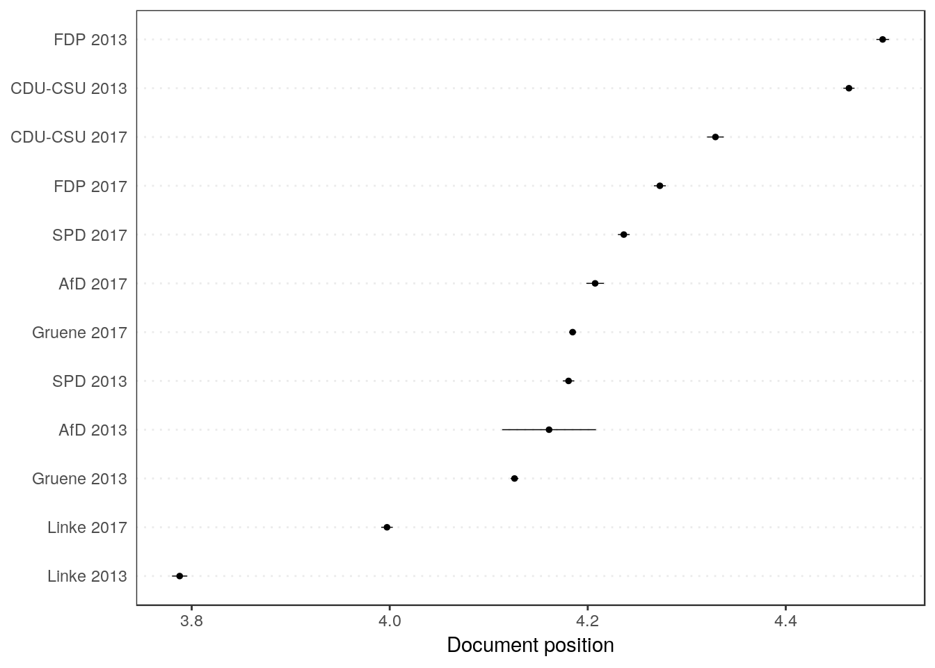
Ideological scaling
Wordfish model (unsupervised)
Wordscore (supervised)

Slide 6
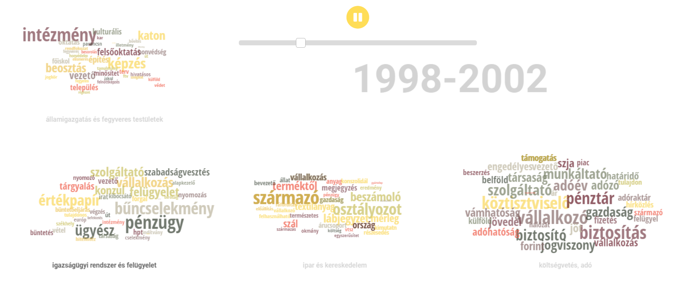
Topic modeling
A Hungarian Academy of Sciences - Centre for Social Sciences project

Slide 7
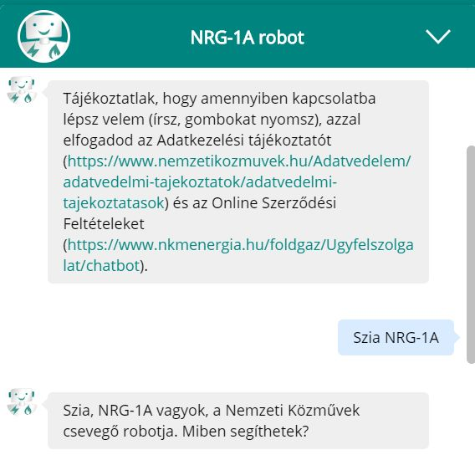
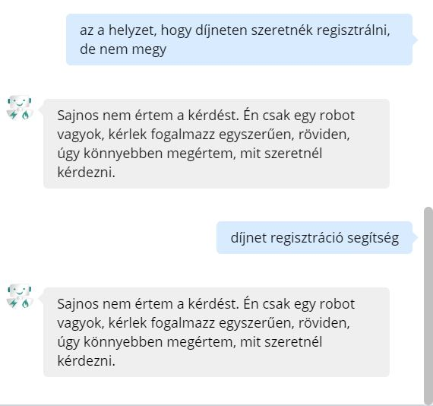
Text mining in business
Chatbots
Me: I’d like to register on díjnet, but I cannot.
Bot: I don’t understand. Say it more simply.
Me: díjnet, registration, help
Bot: I don’t understand. Say it more simply.

Slide 8
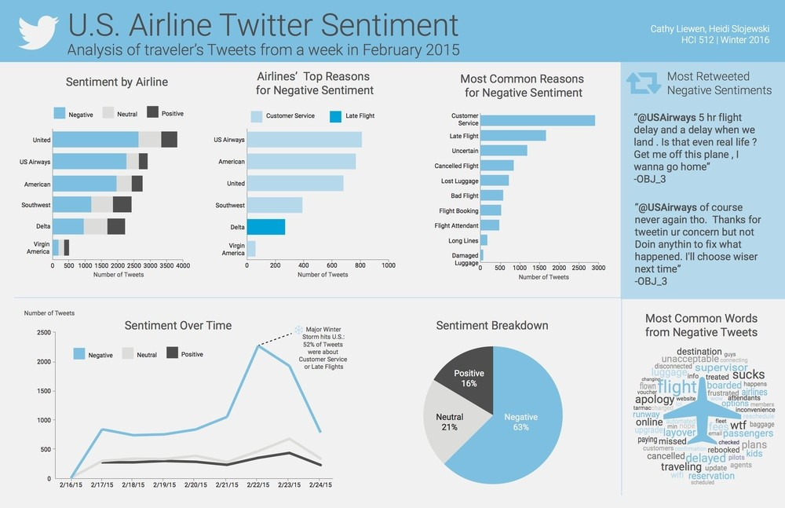
Sentiment analysis

Slide 9
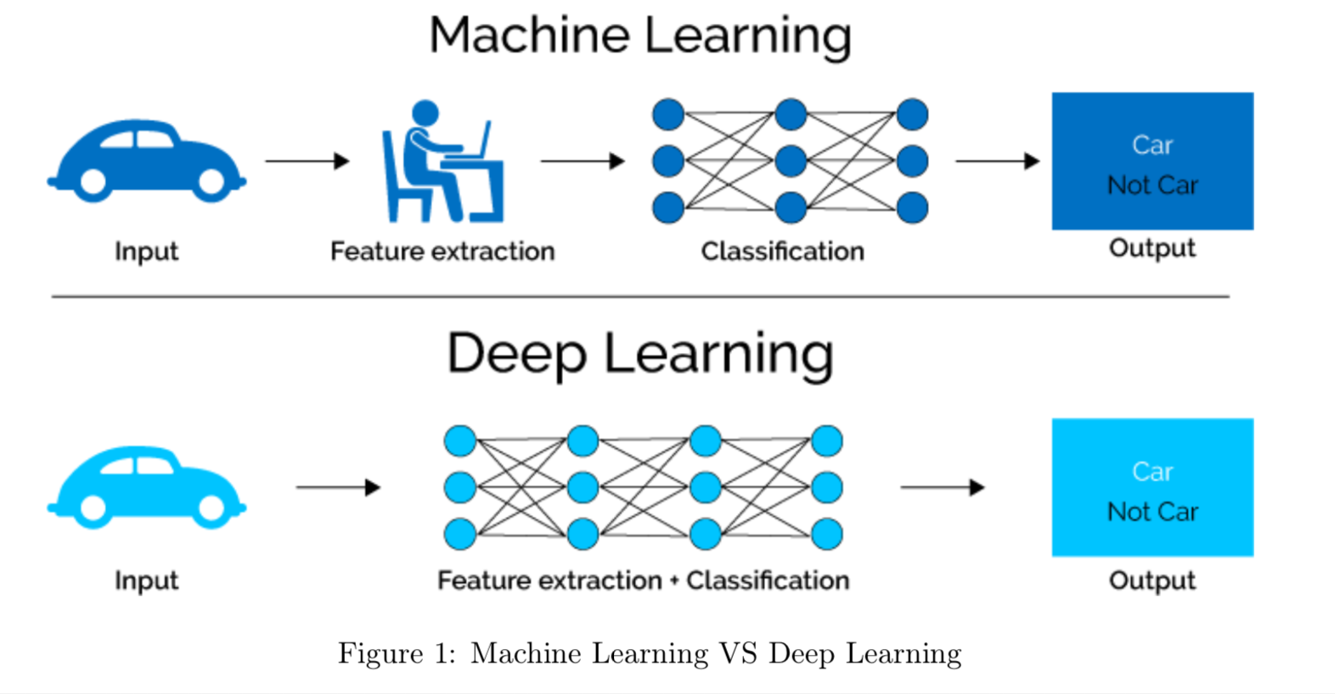
Traditional vs Deep Learning

Slide 10
From text to data
We aim to create a matrix that represents the information in the text, so that our algorithms can work.
How to achieve that?

Slide 11
Bag-of-words (BOW)
Corpus: A collection of texts – the dataset in this case
Document: 1 text – an observation (a sample)
Documents\Words | Word1 | Word2 | … | WordP
Doc1 | Count(1,1) | … | … | Count(1,P)
Doc2 | … | … | … | …
… | … | … | … | …
DocN | Count(N,1) | … | … | Count(N,P)
What information are we losing?

Slide 12
Exploding dimensionality
The resulting text vector is going to have an extremely large number of columns.
Why is that?

Slide 13
Exploding dimensionality
The resulting text vector is going to have an extremely large number of columns.
Why is that?
Dimensionality reduction is achieved through text-preprocessing!
Text-preprocessing ~ Data cleaning in text mining

Slide 14
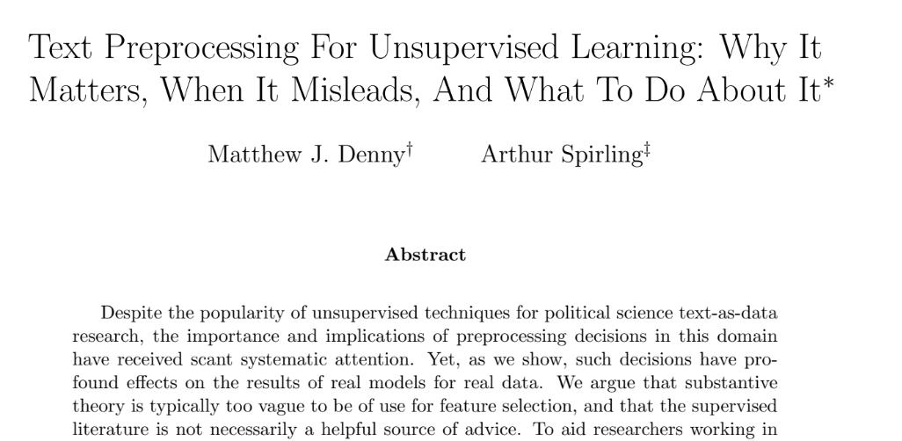
Preprocessing techniques

Slide 15
Text-preprocessing
Framework of Denny & Spirling (2018):
Punctuation
Numbers
Lowercasing
Stemming or lemmatizing
Stopword Removal
N-gram inclusion (combinatorial explosion vs. meaning)
Infrequently used terms

Slide 16
Preprocessing techniques I.
Punctuation and special characters
<h1>This is a heading with html markup</h1> -> This is a heading without html markup.
Let’s roll out to party! ☺#highlife -> Let’s roll out to party highlife
Numbers
Addresses?
References to other text?
Lower-casing
Rose likes to read books. -> rose likes to read books.
Rose, a flower I like. This is a rose. -> rose, a flower i like. this is a rose.

Slide 17
Preprocessing techniques I.
Stemming
<h1>This is a heading with html markup</h1> -> This is a heading without html markup.
Let’s roll out to party! ☺#highlife -> Let’s roll out to party highlife
Stopword removal (domain specificity)
The cat is red. -> cat red.
N-gram inclusion
Combinatorial explosion
United States, French Revolution, Thirty Years' War…
Removal of infrequent or frequent words (vocab size vs information thrown away)

Slide 18
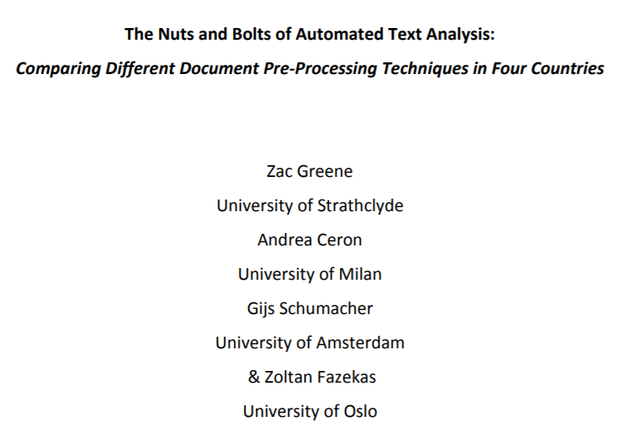
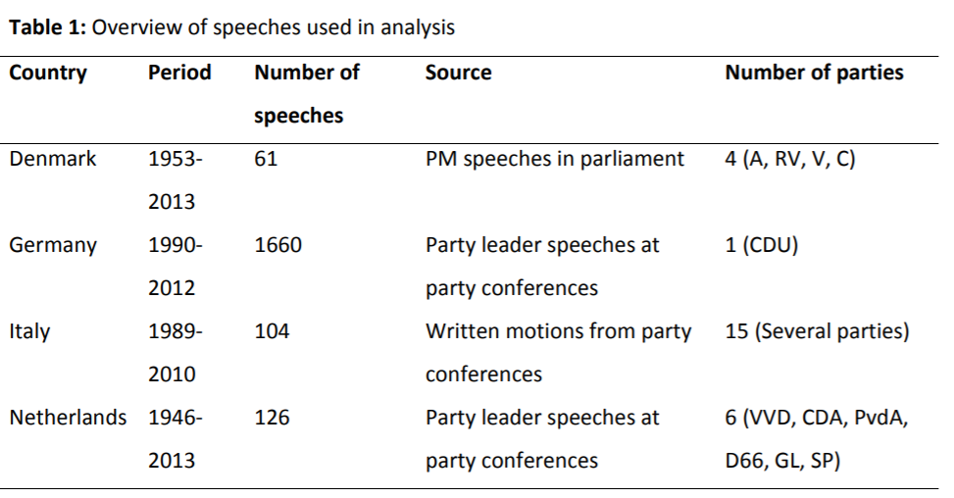
The effect of preprocessing techniques
Examining the effect of different techniques on corpora in different languages.

Slide 19
A case study
github.com/morkapronczay/meetup-talk-text-preproc
Scrape some lists from the internet:
TOP100 most influential people,
TOP100 best cities to live in,
TOP100 best performing companies in 2019,
TOP100 pop/rock bands,
TOP Sport Franchises by value and
TOP100 Books.
Download Wikipedia pages about the mentioned entities.

Slide 20
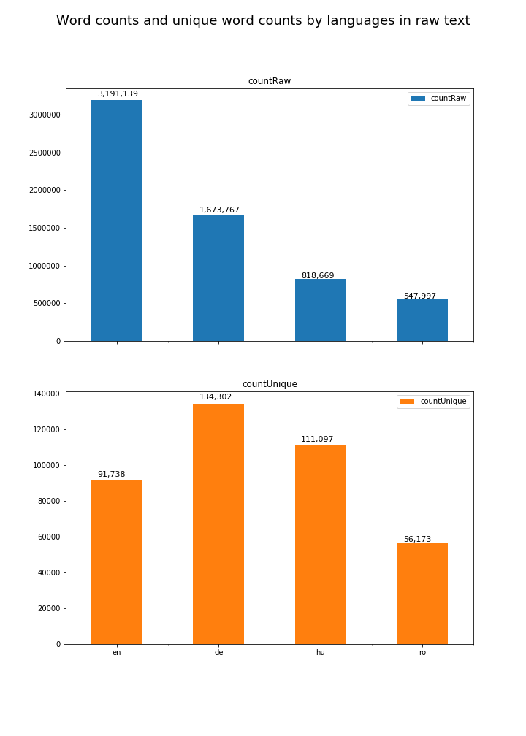
The corpus
Text of 452 wikipedia pages about entities in 4 languages.
A quite general text covering many aspects any text can.
Examine the effect of:
Removing stopwords
Removing both extremely frequent and infrequent words
Stemming, an automated technique to reduce words to their base form
All of them aim to keep relevant information, and throw away the most irrelevant information we can!

Slide 21
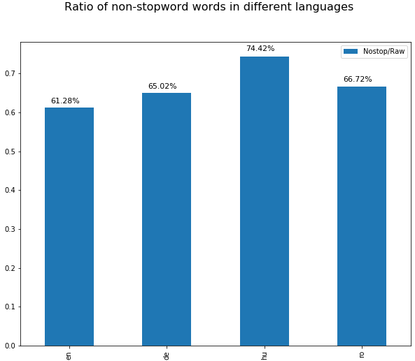
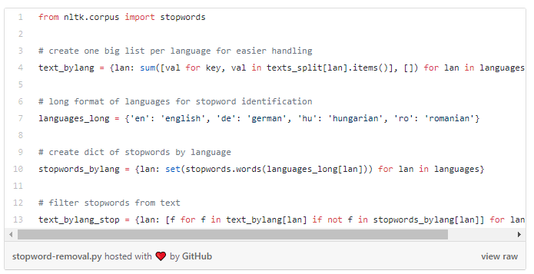
Stopword removal

Slide 22
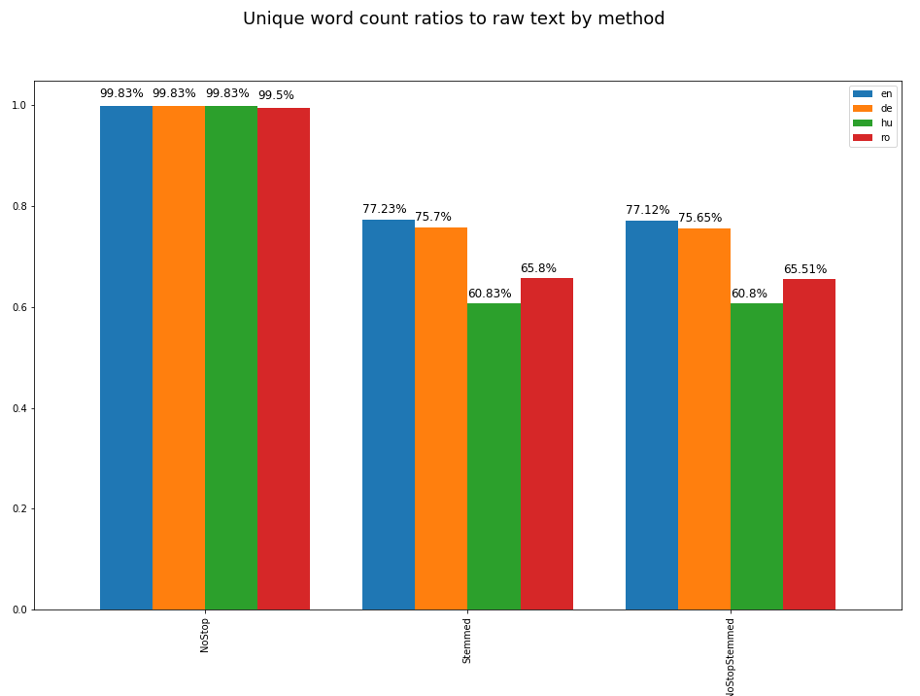
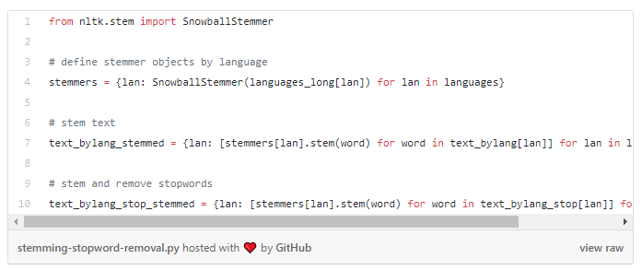
Stemming

Slide 23
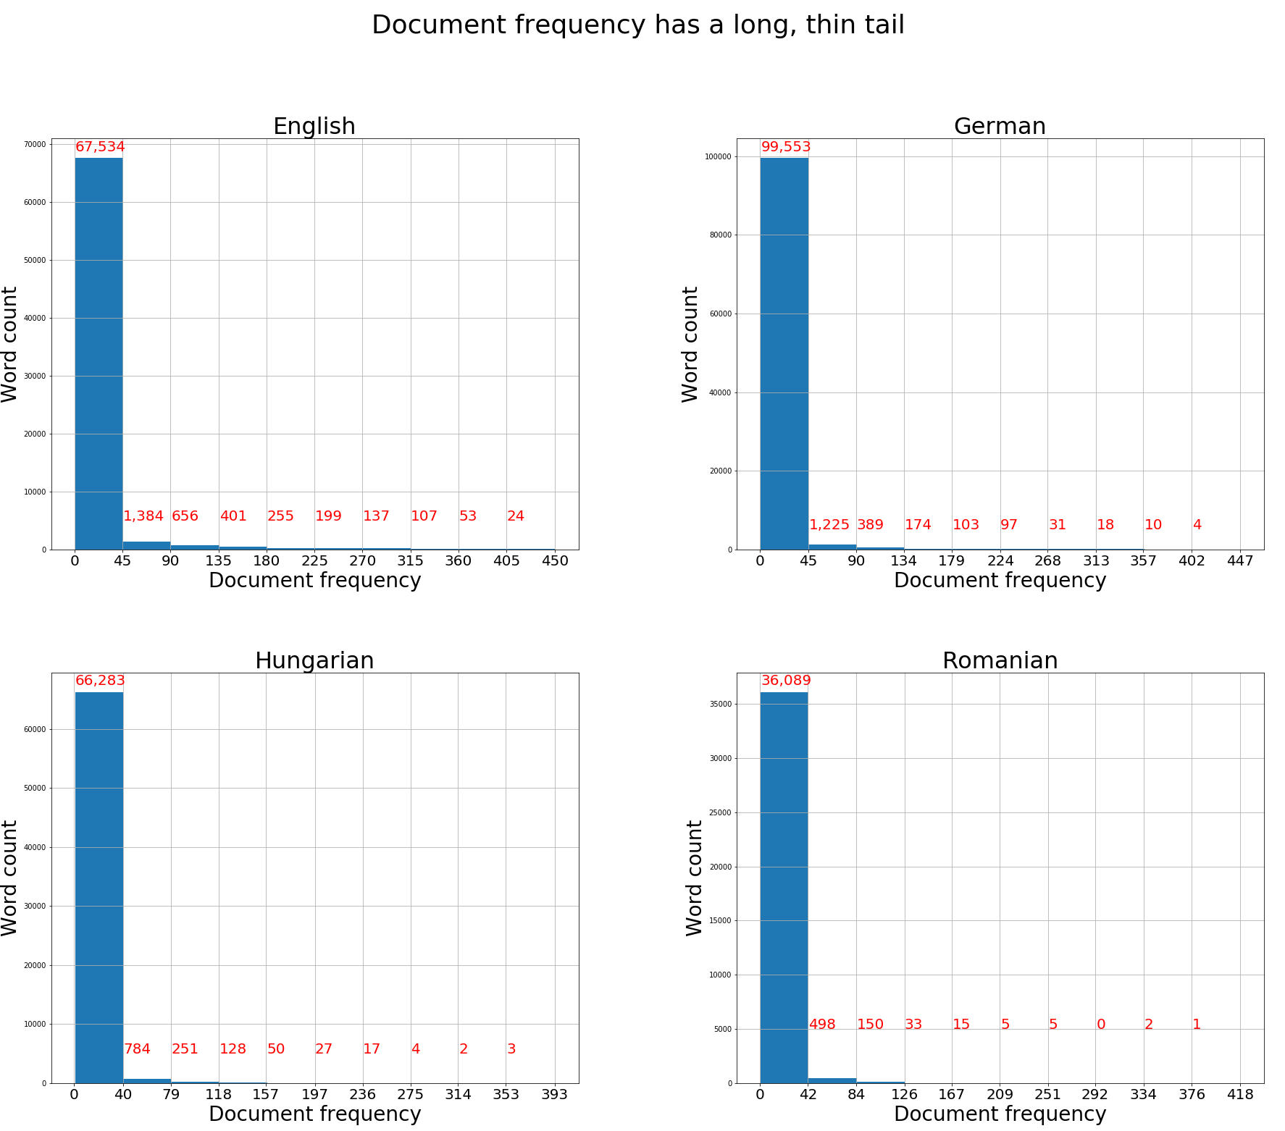
Removal of infrequent words

Slide 24
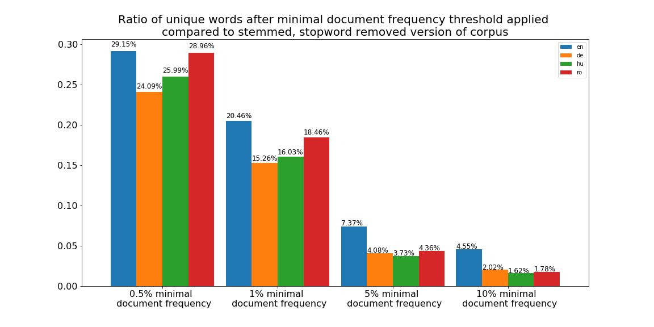
Removal of infrequent words
NOTE: These may be the most important words!

Slide 25
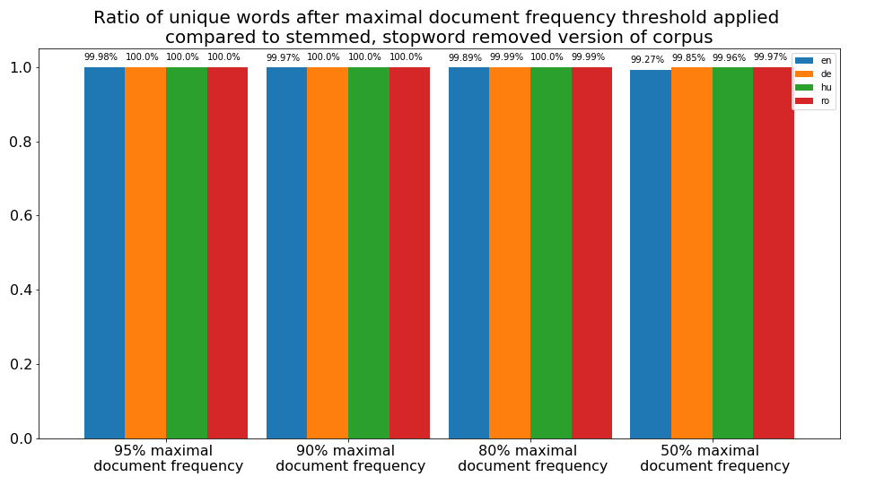
Removal of frequent words
NOTE: In-document frequency may still contain useful information!

